Slide 1

Innovation Day Sponsored by: Single-Family Front-End Technology Capital Markets Technology
August 23, 2018
Property Monitoring Kit

Slide 2
Introduction
ITEM | Description
Project Name | Property Monitoring Kit
Problem Statement | How does Fannie Mae ensure that REO properties remain in good condition until they are sold?
Team Members | Scott Nestor, Kashi Dasa, Sagar Allamshetty, Tim Burns
Technologies used | Elixir, AWS

Slide 3
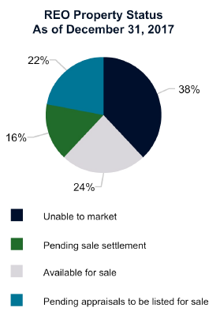
The Problem
By the end of 2017:
$521M of foreclosed property expenses
26K properties (over 16K marketable)
Questions:
How does Fannie Mae monitor the condition of these properties?
How can Fannie Mae avoid sinking extra money into repairs?
Innovation Day | August 23rd 2018

Slide 4
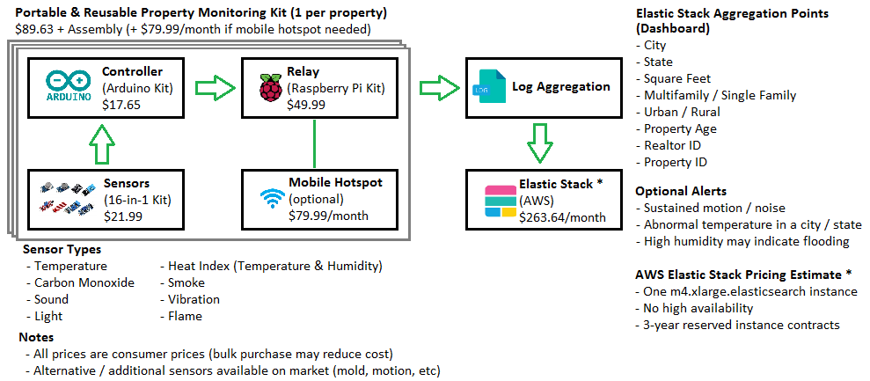
The Solution: Property Monitoring Kit
Innovation Day | August 23rd 2018

Slide 5
Build vs. Buy
 | Fannie Mae Custom Kit | Off-the-shelf (e.g. Ring)
Cost | $89.63 per Kit | $175 per Camera
Sensors | Temperature, Heat Index, CO, Smoke, Flame, Sound, Light, Vibration | Motion (Flood&Freeze in R&D)
Reusable | Yes | No
Cloud Data | Yes | Yes
Cloud Aggregation | Yes | No
Geolocation Data | Yes | No
Data Customization | Yes | No
HD Video Recording | No | Yes
Innovation Day | August 23rd 2018

Slide 6
Applicability: Property Monitoring Kits
Fannie Mae can use Property Monitoring Kits to ensure that marketable REO properties remain in good condition (to avoid additional repair cost/value loss)
Stakeholders:
Fannie Mae (REO Portfolio Managers, Multifamily Guarantee)
Realtors Selling Property
Property Managers
Learned:
Elixir, Client/Server Socket Integration
Elastic Search in AWS
REO Properties, Fannie Mae Financials, Sensor technology
Additional Benefits:
Fannie Mae PR for occupied properties
Smart home/hobbyist use outside Fannie Mae

Slide 7
Property Monitoring Kit: Demo
Innovation Day | August 23rd 2018

Slide 8

Questions and Answers!

Slide 9
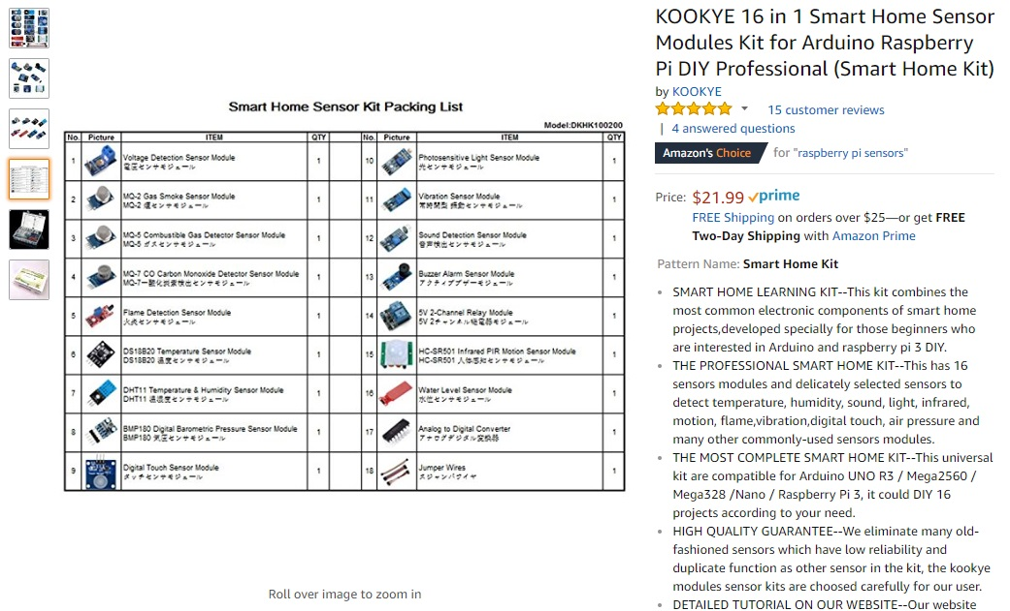
Appendix 1: Sensor Kit Cost
Innovation Day | August 23rd 2018

Slide 10
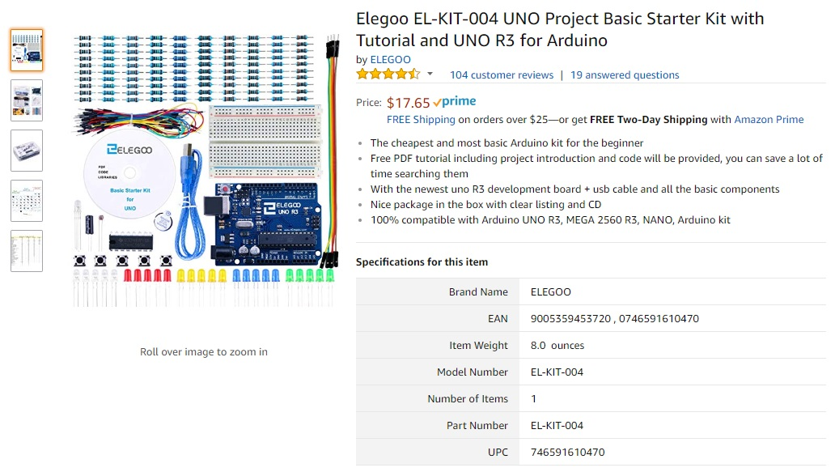
Appendix 2: Arduino Kit Cost
Innovation Day | August 23rd 2018

Slide 11

Appendix 3: Raspberry Pi Kit Cost
Innovation Day | August 23rd 2018

Slide 12
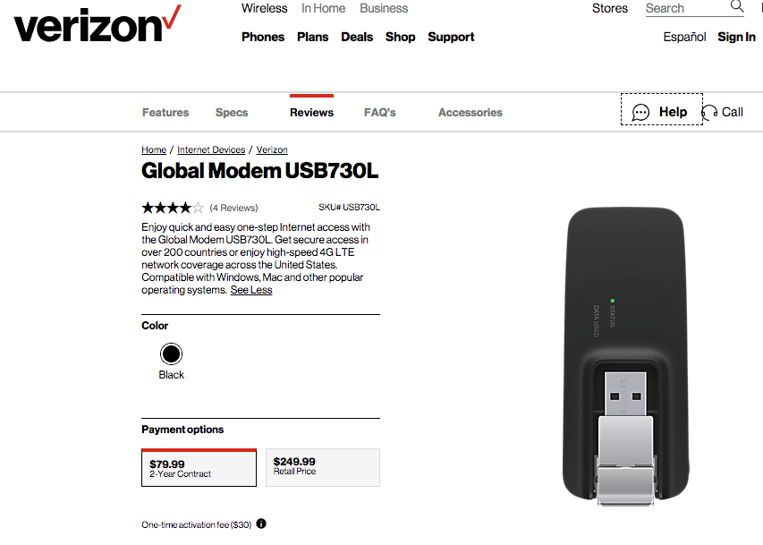
Appendix 4: Mobile Hotspot Cost
Innovation Day | August 23rd 2018

Slide 13
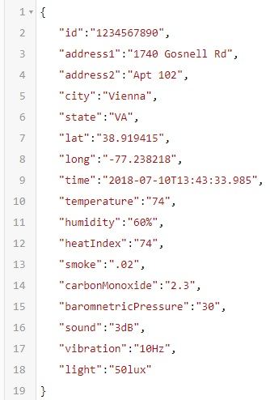
Appendix 5A: AWS Elastic Stack Cost
Assume typical relay payload of 400 UTF-8 characters around 1 byte each
Each Property Monitoring Kit transmits one payload per minute, or 60*24=1440 payloads per day
That's 1,440 minutes * 400 bytes = 576,000 bytes = 562.5 KB = .55 MB per Property Monitoring Kit per day
At the end of 2017, Fannie Mae had around 16K marketable single family REO properties, so that's 16,000*.55 MB = 8789 MB = 8.5 GB per day
We probably don't need to keep the data for longer than 90 days. So that's total ongoing storage capacity of around 90 * 8.5 GB = 765 GB or around 1 TB
Innovation Day | August 23rd 2018

Slide 14
Appendix 5B: AWS Elastic Stack Cost
To calculate AWS Elastic Search prices, I referred to these guides: https://aws.amazon.com/elasticsearch-service/pricing/ https://docs.aws.amazon.com/elasticsearch-service/latest/developerguide/aes-limits.html https://aws.amazon.com/ec2/pricing/reserved-instances/pricing/
The cost is the combination of these three factors:
Amazon Elasticsearch Service instance hours
A single m4.xlarge.elasticsearch instance provides up to 1 TB of EBS size with maximum HTTP request payloads of 100 MB
For a 3-year reserved single instance of m4.xlarge.elasticsearch, that's $3,797.00 for three years (or $105.47 per month)
Amazon EBS storage
General Purpose (SSD) Storage on Amazon EBS Standard volumes : $0.135 per GB / month
765 GB * $0.135 = $103.28 per month
AWS Data Transfer Charges
For a standard 3-year term on a reserved m4.xlarge instance, that's $1,976.00 if paid all up front (or $54.89 per month)
According to these calculations, the AWS Elastic Search cost is 105.47+103.28+54.89=$263.64 per month (I'm not sure if that price includes the cost of running elastic search queries / doing analytics)
To summarize: Around $263.64 per month for Elastic Search (with 3-year contracts)
Innovation Day | August 23rd 2018

Slide 15
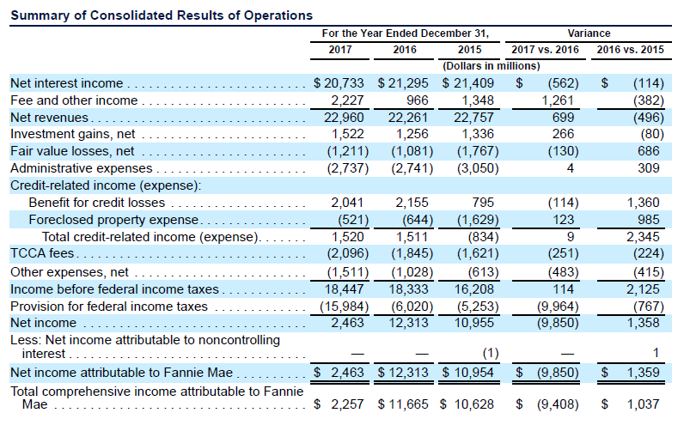
Appendix 6: 2017 10-K Report Page 59
Innovation Day | August 23rd 2018

Slide 16
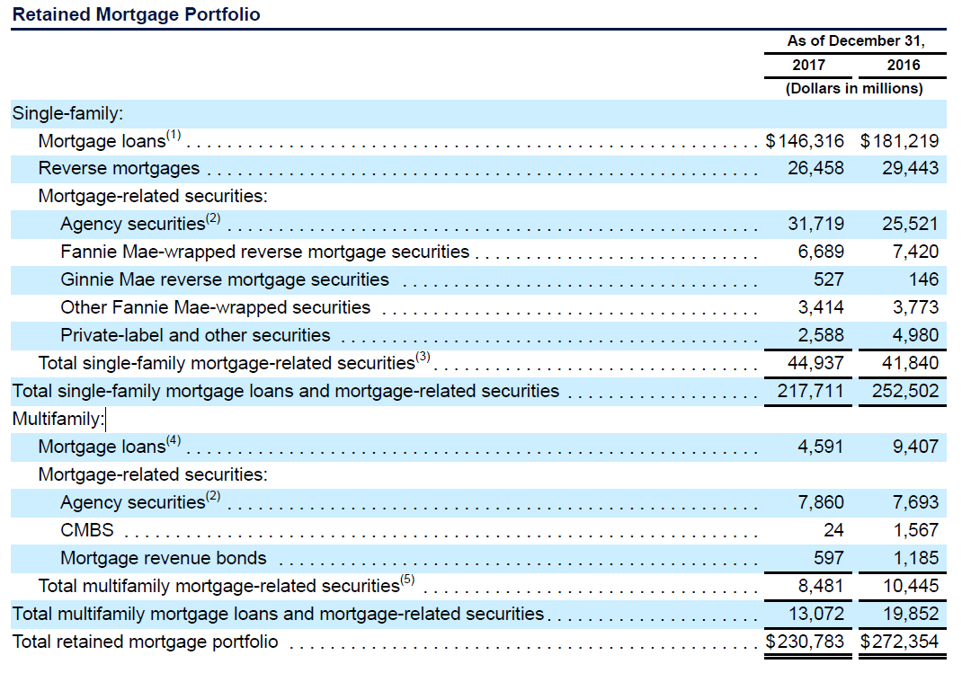
Appendix 6: 2017 10-K Report Page 71
Innovation Day | August 23rd 2018

Slide 17
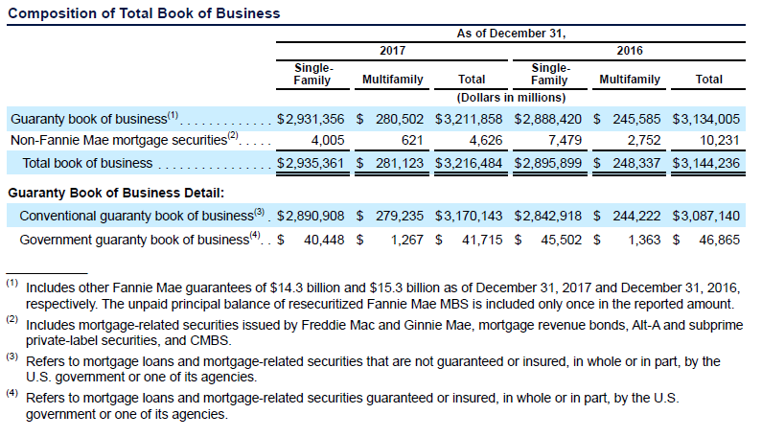
Appendix 6: 2017 10-K Report Page 72
Innovation Day | August 23rd 2018

Slide 18
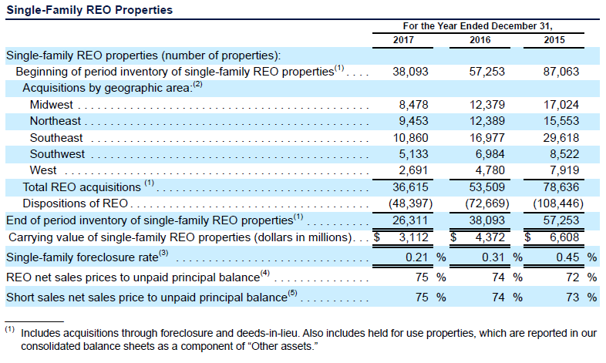
Appendix 6: 2017 10-K Report Page 98
Innovation Day | August 23rd 2018

Slide 19
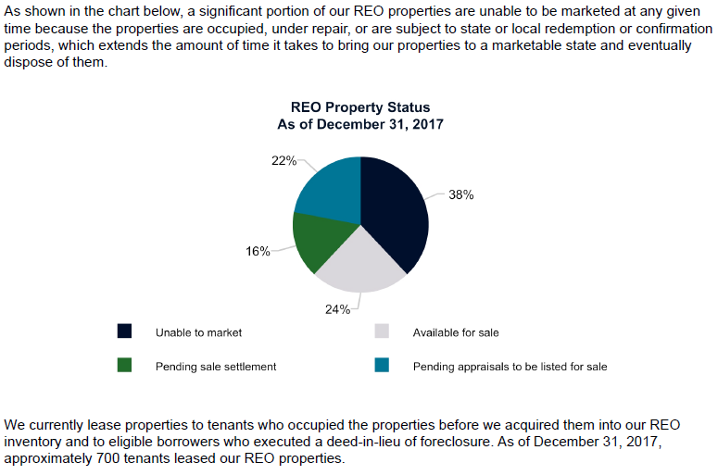
Appendix 6: 2017 10-K Report Page 99
Innovation Day | August 23rd 2018

